Slide 1
Constructor Injection with Dependent Object
We can inject the dependency by constructor.
The <constructor-arg> sub-element of <bean> is used for constructor injection.
We can inject
primitive and String-based values
Dependent object (contained object)
Collection values etc.

Slide 2
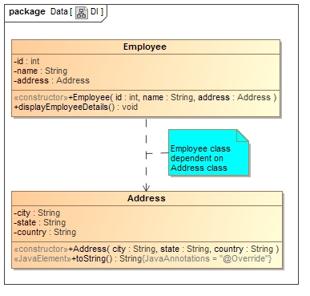
Constructor Injection with Dependent Object
If there is HAS-A relationship between the classes, we create the instance of dependent object (Address Object) first then pass it as an argument of the main class[Employee class] constructor.
Employee HAS-A Address. The Address class object will be termed as the dependent object.

Slide 3
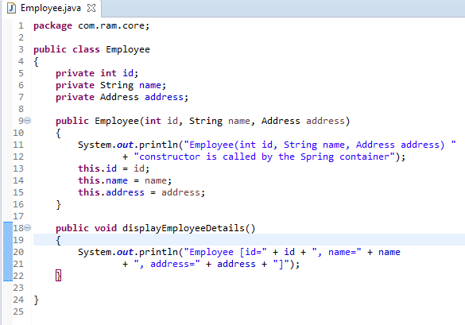

Constructor Injection with Dependent Object

Slide 4
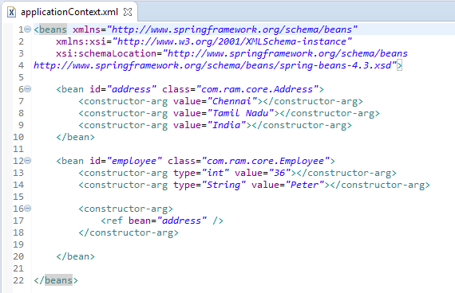
Constructor Injection with Dependent Object
We are providing the information into the bean by applicationContext.xml file.
The constructor-arg element invokes the constructor.The type attributes specifies that int, String, address parameter constructor will be invoked. In this example Employee(int id, String name, Address address) constructor will be invoked.
The ref attribute is used to define the reference of another object, such way we are passing the dependent object as an constructor argument.

Slide 5
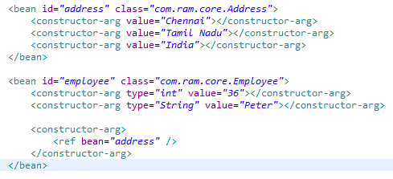
Constructor Injection with Dependent Object
Employee,
Address
What objects to instantiate?
What objects to configure and how to configure?
What objects to be assembled?
The Spring Container
(ApplicationContext)
applicationContext.xml
Employee
Object
Id=36
name=“Peter”
address=Address
[city=Chennai,
state=Tamil Nadu, country=India]]
Create the address and employee objects.
Configure the address and employee objects.
Wire the address and employee objects together.
Manage address and employee objects complete life cycle from creation till destruction.

Slide 6
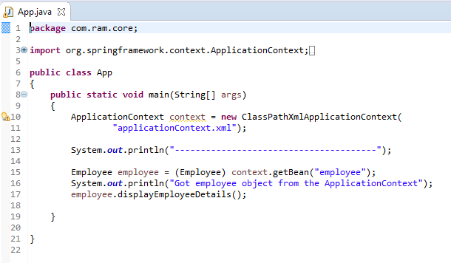

Constructor Injection with Dependent Object

